Slide 1
AUTO MICOMS WRITING SYSTEM
TECHNICAL TEAM
2020. 02. 15
DEV 제조1팀

Slide 2

Catalogue
Block diagram
Software
User interface
Software main function
Setting/creat model
Report manager
Arduino controller board
Conveyor

Slide 3
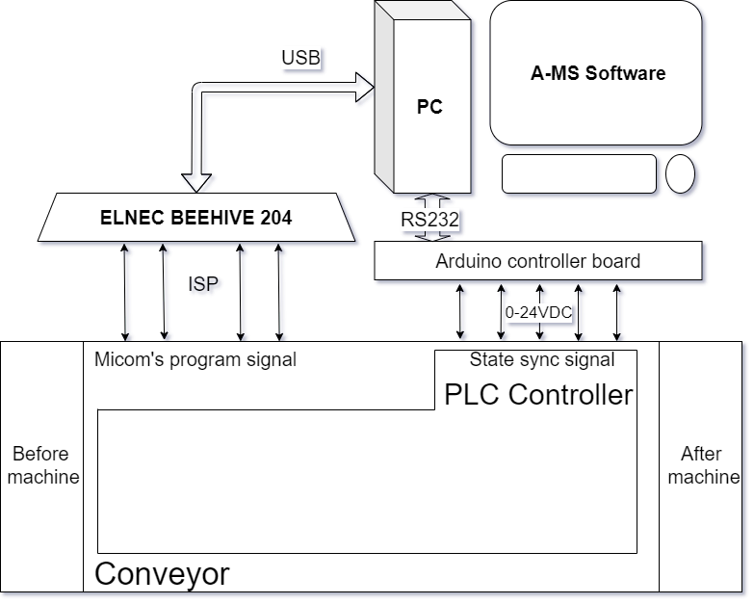
1. Block diagram
Run/Stop conveyor
Up/down Jig
Warning bug
Push NG board

Slide 4
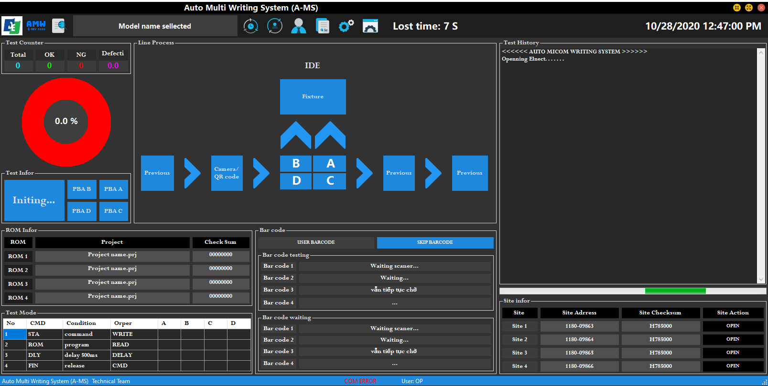
2. Software
a. User interface (Main window)
Toolbar
Statistical
History
Machine layout
Result
ROM info
QR code
Step run
Elnec info

Slide 5
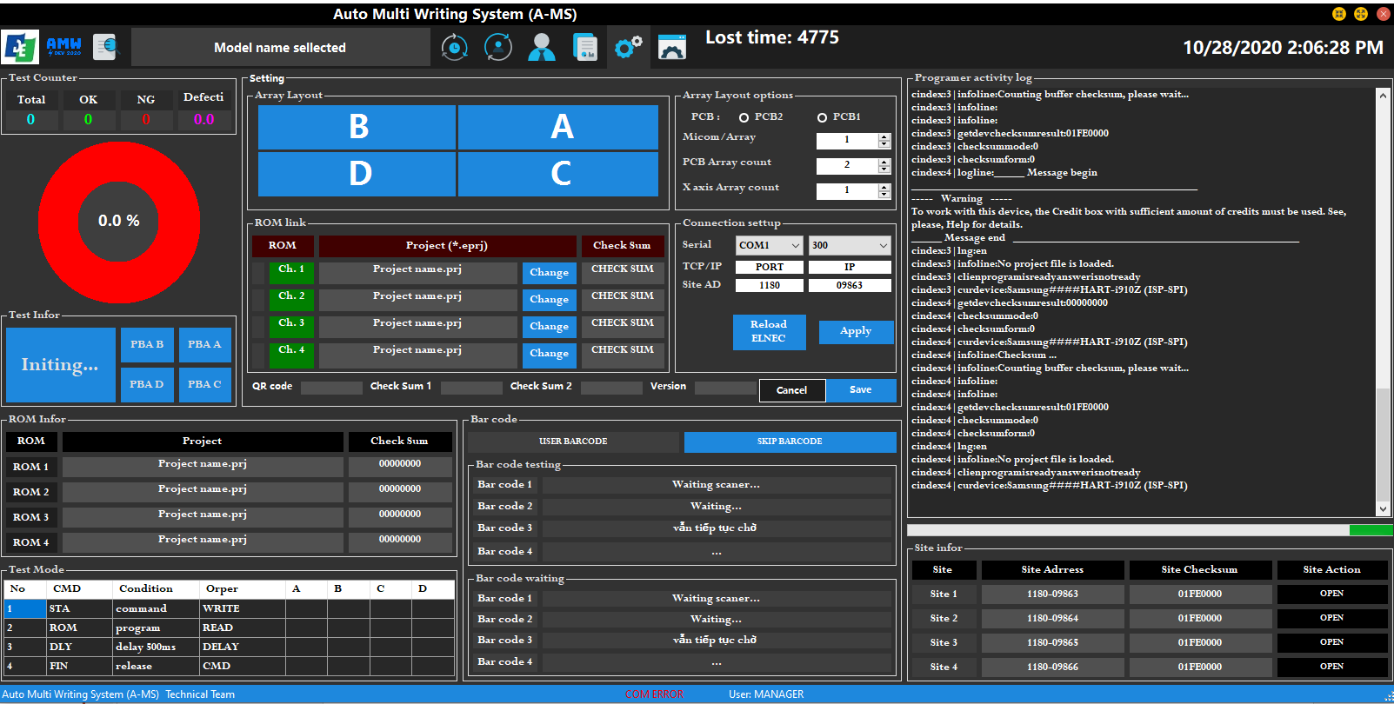
2. Software
a. User interface (Main window)
JIG layout setting
Elnec programmer log
ROM setting
Connect setting

Slide 6
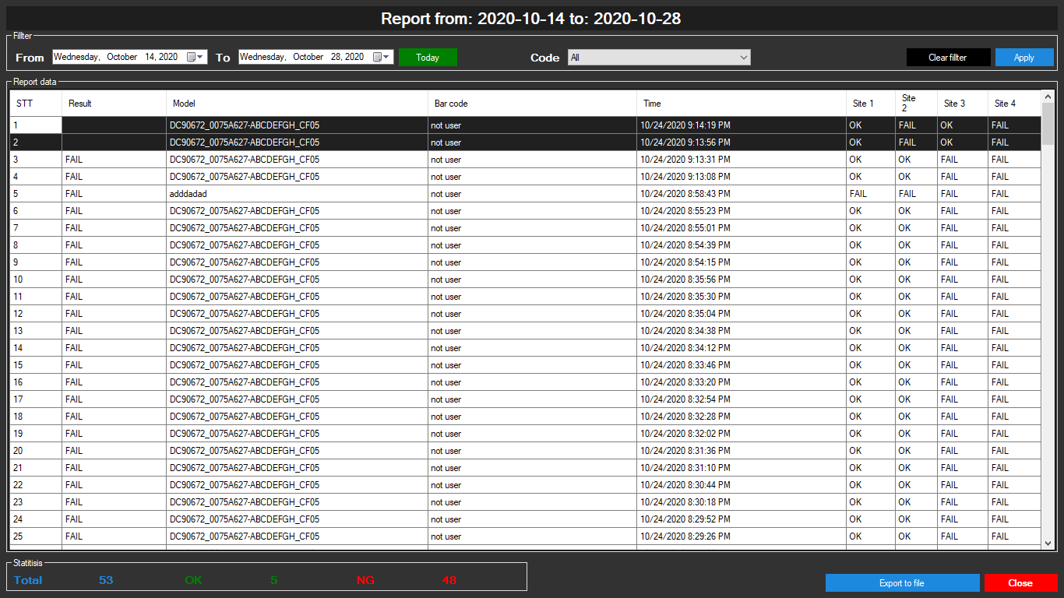
2. Software
a. User interface (Report window)
Report date filter
Report code filter
Report data
Report Statistical
Window action

Slide 7
2. Software
b. Software main function
Load the program at the same time for 4 MCU
Programs at different websites can be the same or different, up to 4 programs
Summarize the results, shown "ON", "FAIL" slot by slot

